Slide 1
On Paper Design
Elevator Control Group 33

Slide 2
8086 Inputs
5 V
VCC
CLK is 5MHz signal
PCLK is 2.5MHz signal
MN/MX
To CLK of 8253
TEST
HLDA
NC
INTR
INTA
15 MHz
X 1
X 2
8259
PCLK
RDY1
RDY2
RESET
RESET
8086
8284
CLK
CLK
5 V
F/C
READY
READY
CYNC
AEN 1
AEN 2
5 V
RES
NMI
HOLD
GND

Slide 3
LS373
A₁₆-A₁₉ S₆-S₃
A₁₆-A₁₉
BHE’/S₇
BHE’
G
OE’
ALE
8086
LS373
AD₈-AD₁₅
A₈-A₁₅
G
OE’
LS373
AD₀-AD₇
A₀-A₇
G
OE’
System Bus of 8086 (Address)
MN/MX’
5V

Slide 4
8086
LS245
AD₈-AD₁₅
D₈-D₁₅
DT/R’
DIR
OE’
DEN’
LS245
AD₀-AD₇
D₀-D₇
DIR
OE’
MN/MX’
5V
System Bus of 8086(Data)

Slide 5







Chip Selects for Memory and Banking Signals
LS138
Chip Select ROM₁
A₁₄ A₁₃ A₁₂
I2
I1
I0
O₀
A₀
Chip Select RAM
Even bank read signal
O₁
$\overline{READ}$ from 8086
A₀
Even bank write signal
$\overline{WRITE}$ from 8086
$$\overline{BHE}$$
Odd bank read signal
GND
G_{2B}
O₇
Chip Select ROM₂
$\overline{READ}$ from 8086
G_{2A} G₁
$$\overline{BHE}$$
Odd bank write signal
$\overline{WRITE}$ from 8086
MEM/$\overline{IO}$ from 8086
GND
Memory Decoder
Read/Write signals for even/odd banks

Slide 6
Memory Interfacing
ROM1
ROM2
RAM
A₁
A₁₁
2716_{1E}
A₁
A₁₁
2716_{2E}
A₀
A₁₀
A₀
A₁₀
D₀
D₇
D₀
D₇
A₁
A₁₁
6116_{1E}
D₀
D₇
D₀
D₇
A₀
A₁₀
D₀
D₇
D₀
D₇
Even bank read signal
Even bank read signal
Even bank write signal
WE’
OE’
CS’
OE’
CS’
OE’
CS’
Even bank read signal
A₁
A₁₁
2716_{1O}
A₁
A₁₁
2716_{2O}
A₀
A₁₀
A₀
A₁₀
D₀
D₇
D₈
D₁₅
A₁
A₁₁
6116_{1O}
D₀
D₇
D₈
D₁₅
A₀
A₁₀
D₀
D₇
D₈
D₁₅
Odd bank read signal
Odd bank read signal
Odd bank write signal
WE’
OE’
CS’
OE’
CS’
OE’
CS’
Odd bank read signal
Chip Select ROM1
Chip Select ROM2
Chip Select RAM

Slide 7
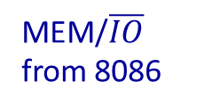






IO Control Signals and Chip Selects for Peripherals Chips
LS138
A₆ A₅ A₄
I2
I1
I0
O₀
Chip Select for 80h
MEM/$\overline{IO}$ from 8086
O₁
$$\overline{IOR}$$
Chip Select for 90h
$\overline{READ}$ from 8086
O₂
Chip Select for A0h
O₃
Chip Select for B0h
O₄
Chip Select for C0h
MEM/$\overline{IO}$ from 8086
$$\overline{IOW}$$
MEM/$\overline{IO}$ from 8086
G_{2B}
$\overline{WRITE}$ from 8086
G_{2A} G₁
A₇
GND

Slide 8






8253 Counter Chips
From PCLK of 8284
D₀
D₇
D₀
D₇
Clk 0
Gate 0
Out 0
D₀
D₇
D₀
D₇
Clk 0
Gate 0
Out 0
From 8255 PC0 operating in BSR mode
5V
Clk 1
Gate 1
Out 1
$$\overline{IOR}$$
$$\overline{IOW}$$
$$\overline{RD}$$
$$\overline{WR}$$
To IR0 of 8259
$$\overline{IOR}$$
$$\overline{IOW}$$
$$\overline{RD}$$
$$\overline{WR}$$
5V
Clk 1
Gate 1
Out 1
From 8255 PC3 operating in BSR mode
A₁
A₂
A₀
A₁
A₁
A₂
A₀
A₁
Clk 2
Gate 2
Out 2
To IR0 of 8259
Chip Select for 80h
$$\overline{CS}$$
Chip Select for 90h
$$\overline{CS}$$
8253
8253
Base Address 80h
Base Address 90h

Slide 9





8259 Priority Interrupt Controller
D₀
D₇
D₀
D₇
From Out0 / Out1 of 8253 at address 90h
IR0
A₀
A₁
From Keyboard
IR1
$$\overline{RD}$$
$$\overline{WR}$$
$$\overline{IOR}$$
$$\overline{IOW}$$
From arrangement of Coarse Sensors 2
IR2
8259
From arrangement of Coarse Sensors 1
IR3
$$\overline{SP/EN}$$
5V
From arrangement of Fine Sensors
IR4
INT
$$\overline{INTA}$$
INTR of 8086
INTA from 8086
$$\overline{CS}$$
Chip Select for A0h
Base Address A0h

Slide 10




8255A operating in BSR mode
D₀
D₇
D₀
D₇
$$\overline{IOR}$$
$$\overline{IOW}$$
$$\overline{RD}$$
$$\overline{WR}$$
PC0
To Gate0 of 8253 at base address 90h
A₁
A₂
A₀
A₁
PC1
To direction control input of motor driver
PC2
To door control electromagnetic system
PC3
To Gate1 of 8253 at base address 90h
Reset from 8284
$$\overline{RESET}$$
8255A
Chip Select for C0h
$$\overline{CS}$$
Base Address C0h

Slide 11



8255A for driving LED Displays, and for interfacing keyboard, operating in mode 0
D₀
D₇
D₀
D₇
PA0
PA1
PA2
PA3
To BCD input of 7447 which controls 7 segment LED Displays for each floor
$$\overline{IOR}$$
$$\overline{IOW}$$
$$\overline{RD}$$
$$\overline{WR}$$
PB0
PB1
PB2
PB3
A₁
A₂
A₀
A₁
To BCD input of 7447 which controls 7 segment LED Display inside the Elevator
Reset from 8284
$$\overline{RESET}$$
PC0
PC1
PC2
PC3
PC4
PC5
PC6
PC7
Column 1 of keyboard
Column 2 of keyboard
Column 3 of keyboard
8255A
Column 4 of keyboard
Row 1 from keyboard
Row 2 from keyboard
Row 3 from keyboard
Chip Select for B0h
$$\overline{CS}$$
Row 4 from keyboard
Base Address B0h

Slide 12
7447 for driving 7 segment LED Displays, one for each floor
OA
OB
OC
OD
OE
OF
OG
7447
A
B
C
D
From Port A of 8255
RBI
RBO
LT
5V
5V

Slide 13
7447 for driving 7 segment LED Display inside the elevator
OA
OB
OC
OD
OE
OF
OG
5V
7447
A
B
C
D
From Port B of 8255
RBI
RBO
LT
5V

Slide 14
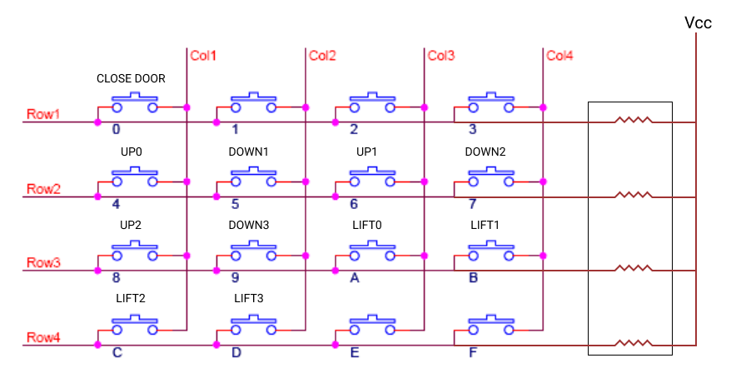
Keyboard arrangement – Keys inside the lift, and on the floors both are interfaced
SN74LVC2G08 is double 2 input AND gate chip SN74LVC1G04 is single inverter chip
Y
SN74LVC1G04
A
Y1
Y2
To IR1 of 8259
SN74LVC2G08
From 8255A at Base Address B0h
A1 B1 A2 B2
PC0
PC1
PC2
PC3
Y1
Y2
SN74LVC2G08
A1 B1 A2 B2
PC4
PC5
To 8255A at Base Address B0h
PC6
PC7

Slide 15
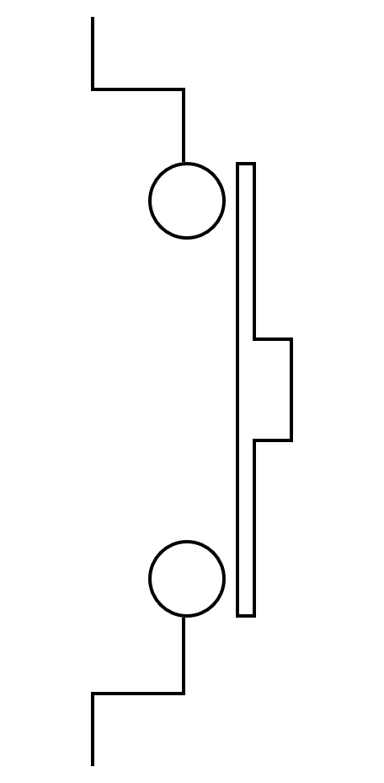
Floor 3 sensors arrangement
5V
To Fine Sensors AND gate
Fine Sensor
To Coarse Sensors 2 AND gate
Coarse Sensor 2

Slide 16
Floor 2 and Floor 1 sensors arrangement (same for both)
5V
To Coarse Sensors 1 AND gate
Coarse Sensor 1
To Fine Sensors AND gate
Fine Sensor
To Coarse Sensors 2 AND gate
Coarse Sensor 2

Slide 17
5V
Floor 0 sensors arrangement
To Coarse Sensors 1 AND gate
Coarse Sensor 1
To Fine Sensors AND gate
Fine Sensor

Slide 18
Chips for generating interrupts from floor sensors
Fine Sensors
Floor 3 Fine Sensor
A1
B1
A2
B2
Y1
A1
B1
A2
B2
SN74LVC1G04
Floor 2 Fine Sensor
Y1
A
Y
To IR4 of 8259
SN74LVC2G08
SN74LVC2G08
Floor 1 Fine Sensor
Y2
Floor 0 Fine Sensor
Y2
SN74LVC2G08 is double 2 input AND gate chip SN74LVC1G04 is single inverter chip
Coarse Sensors 1
Coarse Sensors 2
To IR3 of 8259
To IR2 of 8259
Floor 2 Coarse Sensor
A1
B1
A2
B2
Y1
Floor 3 Coarse Sensor
A1
B1
A2
B2
Y1
Floor 1 Coarse Sensor
Floor 2 Coarse Sensor
SN74LVC2G08
SN74LVC2G08
Floor 0 Coarse Sensor
Y2
A
Y
Floor 1 Coarse Sensor
SN74LVC1G04
Y2
A
Y
SN74LVC1G04

